Slide 1
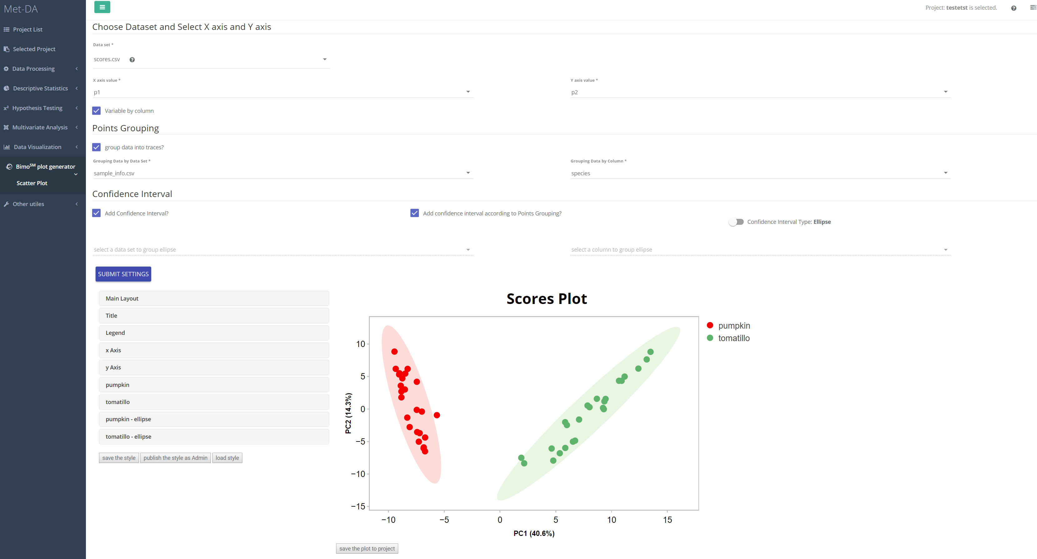
1
2
3
4
6

Slide 2
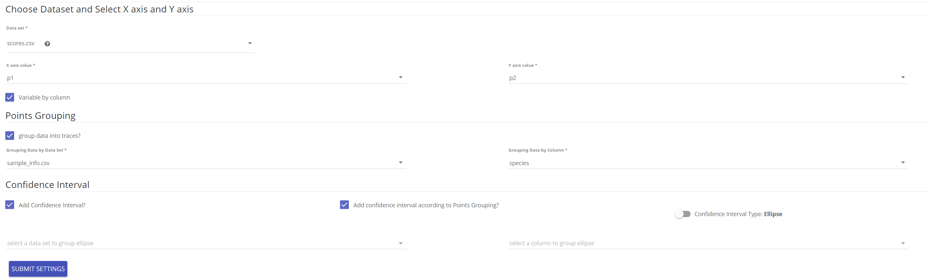
Input parameters
Choose x axis and y axis from a data matrix. For example, the PC1 as x axis and PC2 as y axis from scores.csv
The x axis variable are from column of data matrix, or row of data matrix?
Group the data points into traces so that they can be colored, shapes accordingly.
Whether add confidence interval
1

Slide 3
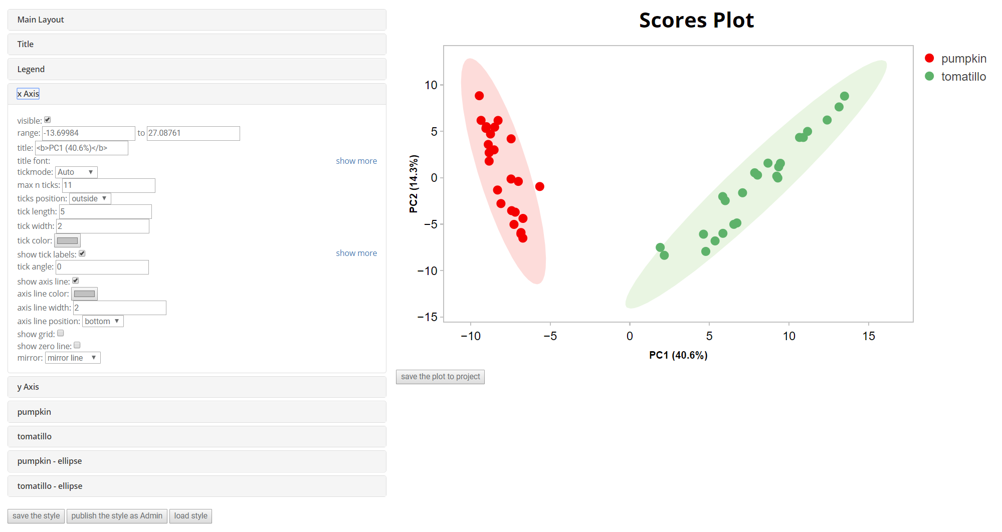
Adjust the graph in multiple ways.
If you do not find what you want, feel free to let us know at slfan@ucdavis.edu.
2
3
Click to save the attribute displayed so that next new scatter plot will use the same attribute.

Slide 4
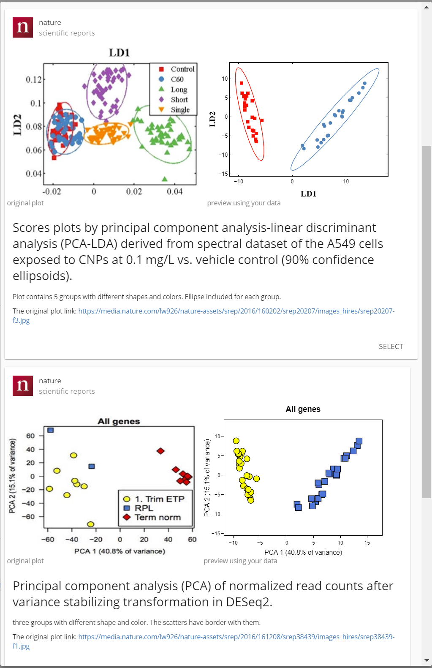
You can even apply a published-style to you plot. We are adding more styles template. If you see any beautiful plot somewhere and would like to apply it to your scatter plot, we are happy to help you. Contact us at slfan@ucdavis.edu
The original plot from a published paper
Preview using your data
4

Slide 5
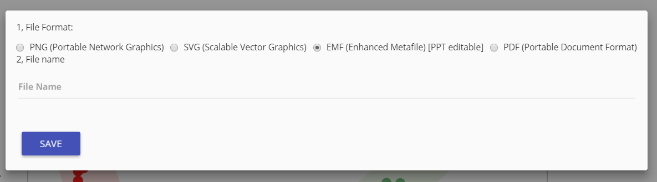
PNG format is commonly used for presentation but not good for publication.
SVG is scalable, namely the resolution does not change when larger your plot. Good for publication and can be further edit using software like Photoshop, Inkscape, etc.
EMF is scalable, namely the resolution does not change when larger your plot. Good for publication and can be further edit using PowerPoint 2016.
PDF is scalable, namely the resolution does not change when larger your plot. Good for publication but cannot be further edit.
Recommended. Download this format and try to use PowerPoint 2016 to edit graph.
5
Journals may have different format requirement, you can always transfer SVG or EMF format to other formats easily using Inkscape or PowerPoint.

